Slide 1
CS1231
Tutorial 3

Slide 2
Thing to note
We will go through sheet 3 today.
As usual, I encourage participation at appropriate times.
Participation includes unmuting, introducing yourself and using the annotate button on zoom.
If you do not wish to participate or , click the cross reaction. If I do not see a cross then I will assume that I can call upon you.
If you want to be want to ensure that you’re called upon then click on the tick reaction.
If you have a question raise your hand. Please save longer and more involved questions for the end of the class. Alternatively you can email me.

Slide 3
Thing to note
You are free to change your reaction as the lesson progresses.
We will not go through * questions. They will be saved for Dr. Wong’s tutorial.

Slide 4
About the quiz

Slide 5
Sheet 3: Questions 1,2&3
The point of these questions is to familiarize yourselves with set notation.
They are warm-up questions. I wouldn’t focus on these during revision.

Slide 6
Sheet 3: Question 1
Which of the following are true?
{1, 2, 4} = {4, 1, 2} : True (Ordering of elements in a set is irrelevant).
b. (b) {5, ∅} = {5} : False (Empty set is an element of left-hand set).
c.{5} ∈ {2, 5} : False (There is a difference between 5 and {5}).

Slide 7
Sheet 3: Question 1
(d) ∅ ∈ {1, 2} : False
(e) {1, 2} ∈ {1, {2, 1}} : True (The order of elements in a set don’t matter).
(f) 1 ∈ {{1, 2}} : False

Slide 8

Sheet 3: Question 2
2. List the elements of the following sets:
(a) {x ∈ N : x is odd and $x^{2}$ < 30};
1, 3, 5.
(b) {x ∈ Z : ∃y ∈ N $x^{2}+y^{2}$= 20}.
−4, −2, 2, 4.

Slide 9

Sheet 3: Question 3
3. Here R is the universal set. Let A = {$x∈ℝ:−2≤x≤1\}$} and
B = {$x:−1<x<3$}.
(a) A ∪ B= {x ∈ R : −2 $≤$ x < 3}.
(b) A ∩ B = {x ∈ R : −1 < x $≤$ 1}.

Slide 10

Sheet 3: Question 3
(c) $\overline{A}$ = {x ∈ R : (x < −2) ∨ (x > 1)}.
(d) $\overline{A}∩\overline{B}$= {x ∈ R : (x < −2) ∨ (x $≥$ 3)}.
(e) A \ B = {x ∈ R : −2 $≤$ x $≤$ −1}.

Slide 11
Sheet 3: Question 4
This question is very important.
Here are the laws of set theory. Remember what these laws are and how to prove them.
We will use these laws to prove more general results in the future.
There are obvious parallels between the laws of set theory and the laws of logic.
You can prove these laws using truth tables, but here will focus on using set notation to familiarize you with prove techniques in set theory.

Slide 12
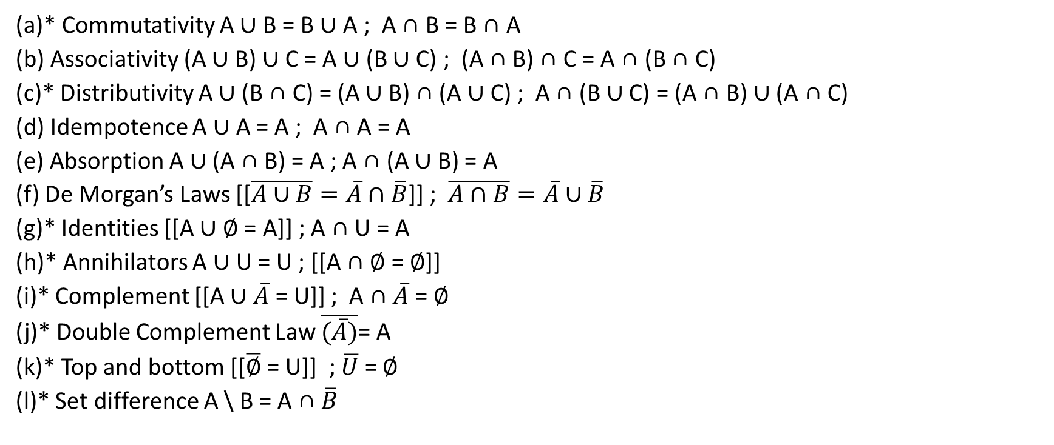
Sheet 3: Question 4
(a)* Commutativity A ∪ B = B ∪ A ; A ∩ B = B ∩ A
(b) Associativity (A ∪ B) ∪ C = A ∪ (B ∪ C) ; (A ∩ B) ∩ C = A ∩ (B ∩ C)
(c)* Distributivity A ∪ (B ∩ C) = (A ∪ B) ∩ (A ∪ C) ; A ∩ (B ∪ C) = (A ∩ B) ∪ (A ∩ C)
(d) Idempotence A ∪ A = A ; A ∩ A = A
(e) Absorption A ∪ (A ∩ B) = A ; A ∩ (A ∪ B) = A
(f) De Morgan’s Laws [[$\overline{A∪B}=\overline{A}∩\overline{B}$]] ; $\overline{A∩B}=\overline{A}∪\overline{B}$
(g)* Identities [[A ∪ ∅ = A]] ; A ∩ U = A
(h)* Annihilators A ∪ U = U ; [[A ∩ ∅ = ∅]]
(i)* Complement [[A ∪ $\overline{A}$ = U]] ; A ∩ $\overline{A}$ = ∅
(j)* Double Complement Law $\overline{(\overline{A})}$= A
(k)* Top and bottom [[$\overline{∅}$ = U]] ; $\overline{U}$ = ∅
(l)* Set difference A \ B = A ∩ $\overline{B}$

Slide 13
Sheet 3: Question 4 (Participation)
(b) Associativity (A ∪ B) ∪ C = A ∪ (B ∪ C)

Slide 14
Sheet 3: Question 4
(b) Associativity (A ∪ B) ∪ C = A ∪ (B ∪ C)
z ∈ (A ∩ B) ∩ C ⇔ (z ∈ A ∩ B) ∧ z ∈ C by the definition of ∩;
⇔ (z ∈ A ∧ z ∈ B) ∧ z ∈ C by the definition of ∩;
⇔ z ∈ A ∧ (z ∈ B ∧ z ∈ C) as ∧ is associative;
⇔ z ∈ A ∧ (z ∈ B ∩ C) by the definition of ∩;
⇔ z ∈ A ∩ (B ∩ C) by the definition of ∩.
So (A ∩ B) ∩ C = A ∩ (B ∩ C).

Slide 15
Sheet 3: Question 4 (Participation)
(c)* Distributivity A ∪ (B ∩ C) = (A ∪ B) ∩ (A ∪ C)

Slide 16
Sheet 3: Question 4
(c)* Distributivity A ∪ (B ∩ C) = (A ∪ B) ∩ (A ∪ C)
A ∪ (B ∩ C)
= {x : (x ∈ A) ∨ (x ∈ B ∩ C)} by the definition of ∪;
= {x : (x ∈ A) ∨ (x ∈ B ∧ x ∈ C)} by the definition of ∩;
= {x : ((x ∈ A) ∨ (x ∈ B)) ∧ ((x ∈ A) ∨ (x ∈ C))} as ∨ distributes over ∧;
= {x : (x ∈ A ∪ B) ∧ (x ∈ A ∪ C)} by the definition of ∪;
= (A ∪ B) ∩ (A ∪ C) by the definition of ∩.

Slide 17

Sheet 3: Question 4 (Participation)
(f) De Morgan’s Laws $\overline{A∩B}=\overline{A}∪\overline{B}$

Slide 18

Sheet 3: Question 4
(f) De Morgan’s Laws $\overline{A∩B}=\overline{A}∪\overline{B}$
$$x∈\overline{A∩B}$$
$$⟺x∉A∩B$$
$$⟺(x∉A)∨(x∉B)$$
$$⟺(x∈\overline{A})∨(x∈\overline{B})$$
$⟺x∈\overline{A}∪\overline{B}$.

Slide 19
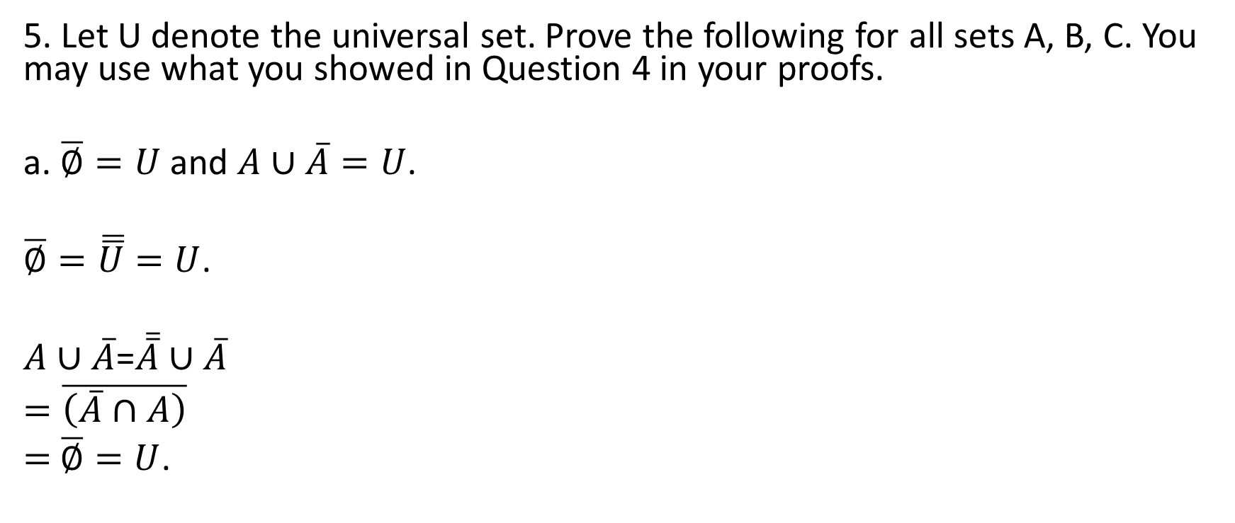
Sheet 3: Question 5
5. Let U denote the universal set. Prove the following for all sets A, B, C. You may use what you showed in Question 4 in your proofs.
a. $\overline{∅}=U$ and $A∪\overline{A}=U$.
$\overline{∅}=\overline{\overline{U}}=U$.
$A∪\overline{A}$=$\overline{\overline{A}}∪\overline{A}$
$=\overline{\left(\overline{A}∩A\right)}$
$=$ $\overline{∅}=U$.

Slide 20
Sheet 3: Question 5
(c) If A ⊆ B and A ⊆ C, then A ⊆ B ∩ C.
Suppose A ⊆ B and A ⊆ C. This means that if x ∈ A, then x ∈ B and x ∈ C, and thus x ∈ B ∩ C. So A ⊆ B ∩ C.

Slide 21
Sheet 3: Question 5
(e) If A ⊆ B, then A ∩ C ⊆ B ∩ C.
Suppose A ⊆ B. Example 4.3.8 in the notes then tells us A ∩ C ⊆ A ⊆ B and A ∩ C ⊆ C. So A ∩ C ⊆ B ∩ C by (c).

Slide 22
Sheet 3: Question 5
(f) B ⊆ A if and only if A ∩ B = B.
(f) (⇒) Suppose B ⊆ A. Then B ∩ B ⊆ A ∩ B by (e). So B ⊆ A ∩ B.
Conversely, Example 4.3.8 in the notes tells us A ∩ B ⊆ B.
Hence A ∩ B = B.
(⇐) Suppose A ∩ B = B. Then B = A ∩ B ⊆ A by Example 4.3.8 in the notes.

Slide 23
Sheet 3: Questions 6&7
Simple exercises on set theory.
Instances on when paying attention to detail benefits you.

Slide 24
Sheet 3: Question 6
6. In lexical analysis (CS4212), regular expressions are used to describe how tokens are constructed from strings. The basic construction is concatenation: If x and y are strings, then xy is thestring formed by the symbols of x followed by the symbols of y;
If X and Y are sets of strings, define XY = {xy : x ∈ X ∧ y ∈ Y }.

Slide 25
Sheet 3: Question 6
Let X = {1, 01, 11, 011} and Y = {00, 100}. Determine XY , Y X and XX.
X = {1, 01, 11, 011}, Y = {00, 100}.
XY = {100, 1100, 0100, 01100, 11100, 011100}.
Note: XY has 6 elements, not 8.
Y X = {001, 1001, 0001, 10001, 0011, 10011, 00011, 100011}
XX = {11, 101, 111, 1011, 011, 0101, 0111, 01011, 1101, 1111, 11011, 01101, 01111, 011011}.
Note: XX has 14 elements, not 16.

Slide 26
Sheet 3: Question 6
(b) If S is a set of strings, what is ∅S?
(b) If w ∈ ∅S, then w = xy for some x ∈ ∅ and y ∈ S.
But there is no x ∈ ∅. So there can be no w ∈ ∅S. This means ∅S = ∅

Slide 27
Sheet 3: Question 7
Determine P(P(∅)).
P(P(∅)) = P({∅}) = {∅, {∅}}.
How about P(P(P(∅)))?

Slide 28
Sheet 3: Question 8 (Participation)
8. For each of the following, determine whether it is true for all sets A, B.
(a) P(A) ∪ P(B) ⊆ P(A ∪ B).

Slide 29
Sheet 3: Question 8
(a) Let S ∈ P(A) ∪ P(B).
If S ∈ P(A), then S ⊆ A, so S ⊆ A ∪ B, i.e. S ∈ P(A ∪ B). Similarly for S ∈ P(B). Thus P(A) ∪ P(B) ⊆ P(A ∪ B).

Slide 30
Sheet 3: Question 8
(b) P(A ∪ B) ⊆ P(A) ∪ P(B).

Slide 31

Sheet 3: Question 8
(b) Consider A = {2} and B = {3}. Then {2, 3} ∈ P(A ∪ B).
But P(A) ∪ P(B) = {∅, {2}, {3}}. So {2, 3} $∉$ P (A) ∪ P(B).
Therefore P(A ∪ B) $⊈$ P(A) ∪ P(B) in general.

Slide 32

Sheet 3: Question 8 (Extension)
$P\left(A∩B\right)=P\left(A\right)∩P\left(B\right)$
$C∈P\left(A∩B\right)$
$⟺C⊆A∩B$
$⟺C⊆A,B$
$⟺C∈P(A)∩P(B)$ .

Slide 33
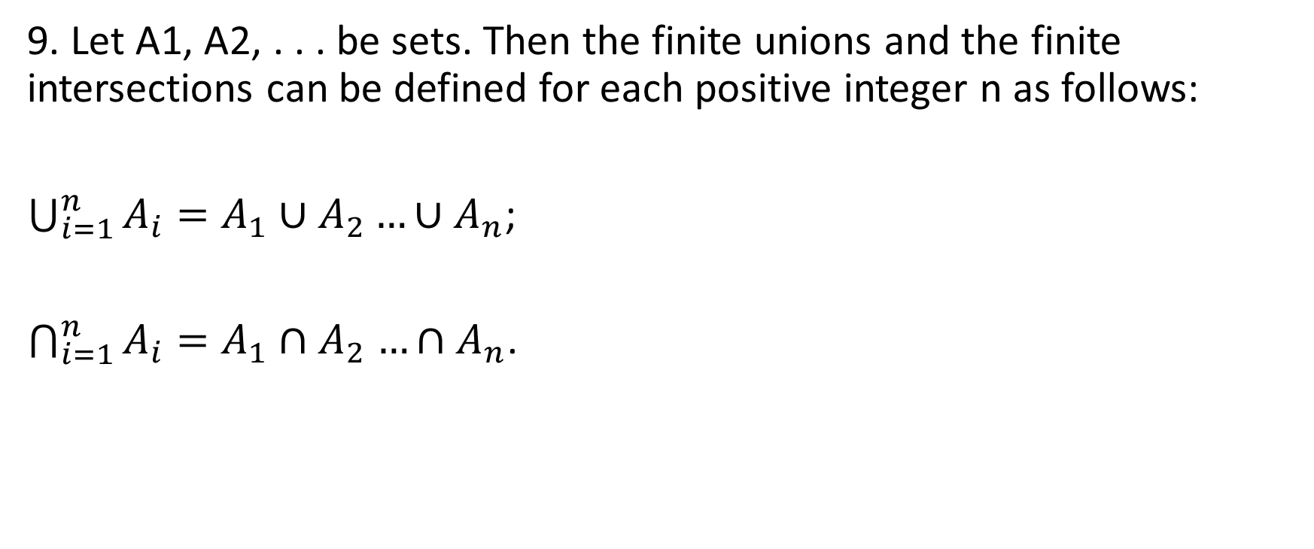
Sheet 3: Question 9
9. Let A1, A2, . . . be sets. Then the finite unions and the finite intersections can be defined for each positive integer n as follows:
$\bigcup_{i=1}^{n}{A_{i}=A_{1}∪A_{2}…∪A_{n}}$;
$\bigcap_{i=1}^{n}{A_{i}=A_{1}{∩A}_{2}…{∩A}_{n}}$.

Slide 34
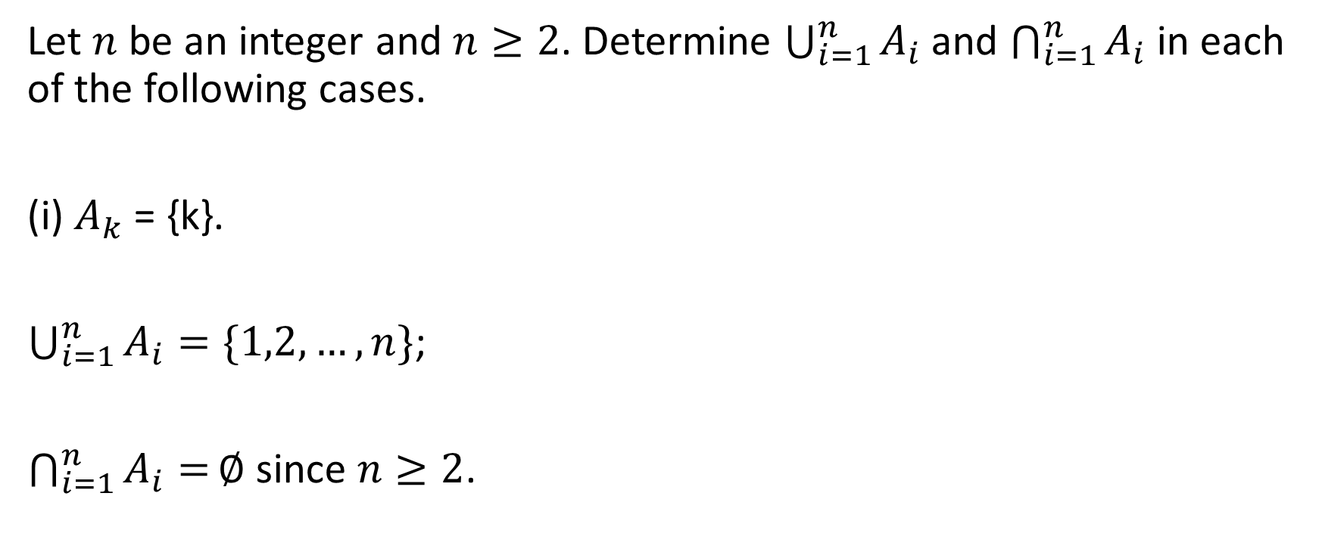
Sheet 3: Question 9
Let $n$ be an integer and $n≥2$. Determine $\bigcup_{i=1}^{n}{A_{i}}$ and $\bigcap_{i=1}^{n}{A_{i}}$ in each of the following cases.
(i) $A_{k}$ = {k}.
$\bigcup_{i=1}^{n}{A_{i}}=\{1,2,…,n\}$;
$\bigcap_{i=1}^{n}{A_{i}=}∅$ since $n≥2$.

Slide 35

Sheet 3: Question 9
(ii) $A_{k}$ = {x ∈ $ℝ$ : 0 < x < k}
$\bigcup_{i=1}^{n}{A_{i}}=\{x∈ℝ:0<x<n\}$;
$\bigcap_{i=1}^{n}{A_{i}=\{x∈ℝ:0<x<1\}}$.

Slide 36

Sheet 3: Question 9
(iii) $A_{k}=\left\{x∈ℝ:0≤x≤\frac{1}{k}\right\}.$
$\bigcup_{i=1}^{n}{A_{i}}=\{x∈ℝ:0≤x≤1\}$;
$\bigcap_{i=1}^{n}{A_{i}=\{x∈ℝ:0≤x≤\frac{1}{n}\}}$.

Slide 37
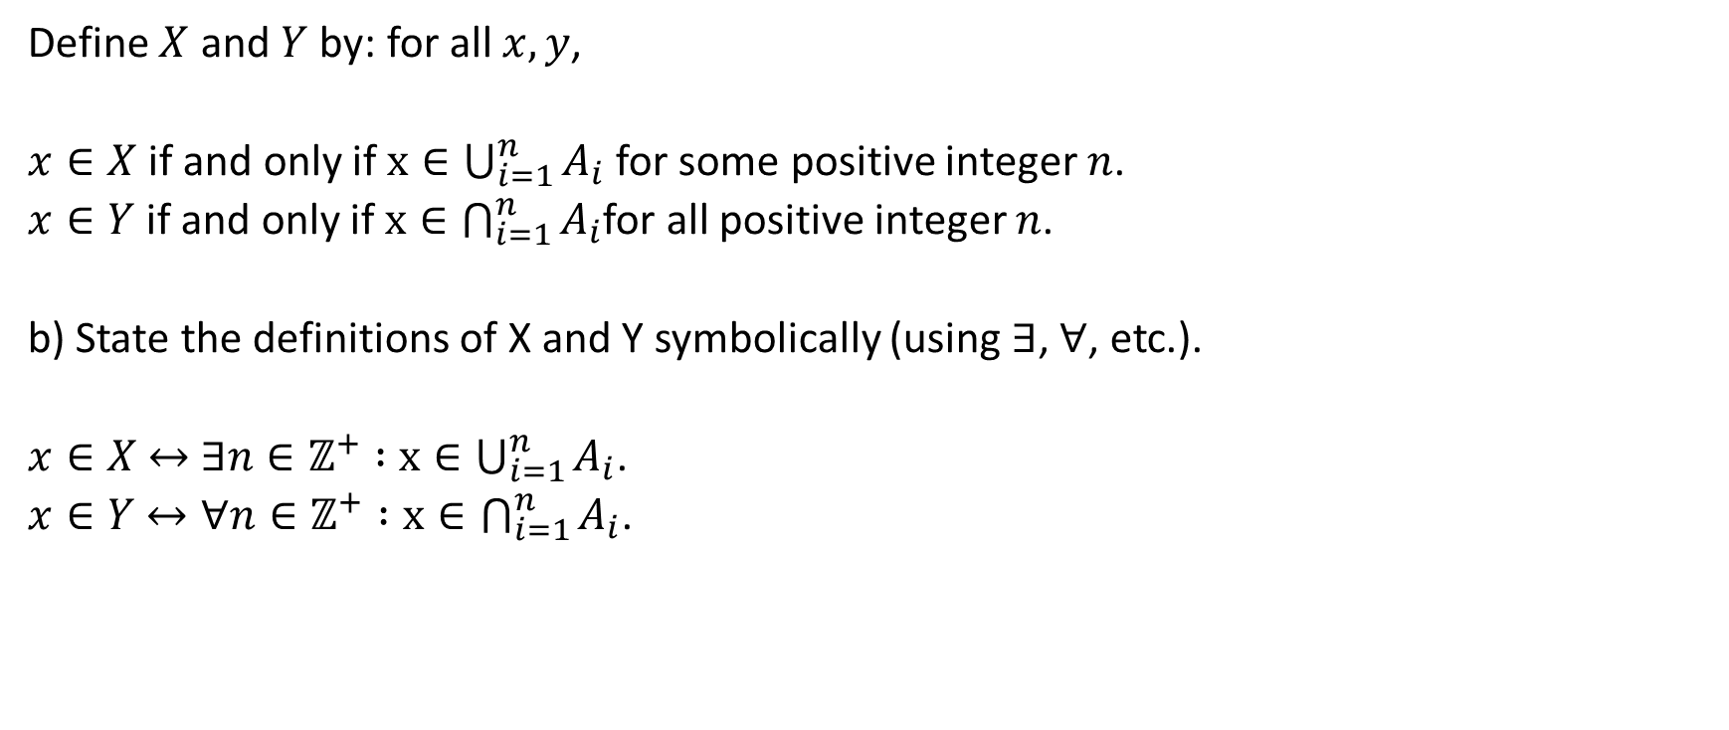
Sheet 3: Question 9
Define $X$ and $Y$ by: for all $x,y$,
$x∈X$ if and only if $x∈\bigcup_{i=1}^{n}{A_{i}}$ for some positive integer $n$.
$x∈Y$ if and only if $x∈\bigcap_{i=1}^{n}{A_{i}}$for all positive integer $n$.
b) State the definitions of X and Y symbolically (using ∃, ∀, etc.).
$x∈X$ $↔$ $∃n∈ℤ^{+} :$ $x∈\bigcup_{i=1}^{n}{A_{i}}$.
$x∈Y$ $↔∀n∈ℤ^{+} :x∈\bigcap_{i=1}^{n}{A_{i}}$.

Slide 38

Sheet 3: Question 9
(c) Determine X and Y for the three cases in (a).
(i) $A_{k}$ = {k}.
$\bigcup_{i=1}^{n}{A_{i}}=\{1,2,…,n\}$;
X = $ℤ^{+}$;
$\bigcap_{i=1}^{n}{A_{i}=}∅$ since $n≥2;$
Y = ∅.

Slide 39

Sheet 3: Question 9
(ii) $A_{k}$ = {x ∈ $ℝ$ : 0 < x < k}
$\bigcup_{i=1}^{n}{A_{i}}=\{x∈ℝ:0<x<n\}$;
$X=ℝ^{+}$;
$\bigcap_{i=1}^{n}{A_{i}=\{x∈ℝ:0<x<1\}};$
$Y=\{x∈ℝ:0<x<1\}$ .

Slide 40

Sheet 3: Question 9
(iii) $A_{k}=\left\{x∈ℝ:0≤x≤\frac{1}{k}\right\}.$
$\bigcup_{i=1}^{n}{A_{i}}=\{x∈ℝ:0≤x≤1\}$;
$X=\{x∈ℝ:0≤x≤1\}$;
$\bigcap_{i=1}^{n}{A_{i}=\{x∈ℝ:0≤x≤\frac{1}{n}\}};$
$Y=\{0\}$.

Slide 41
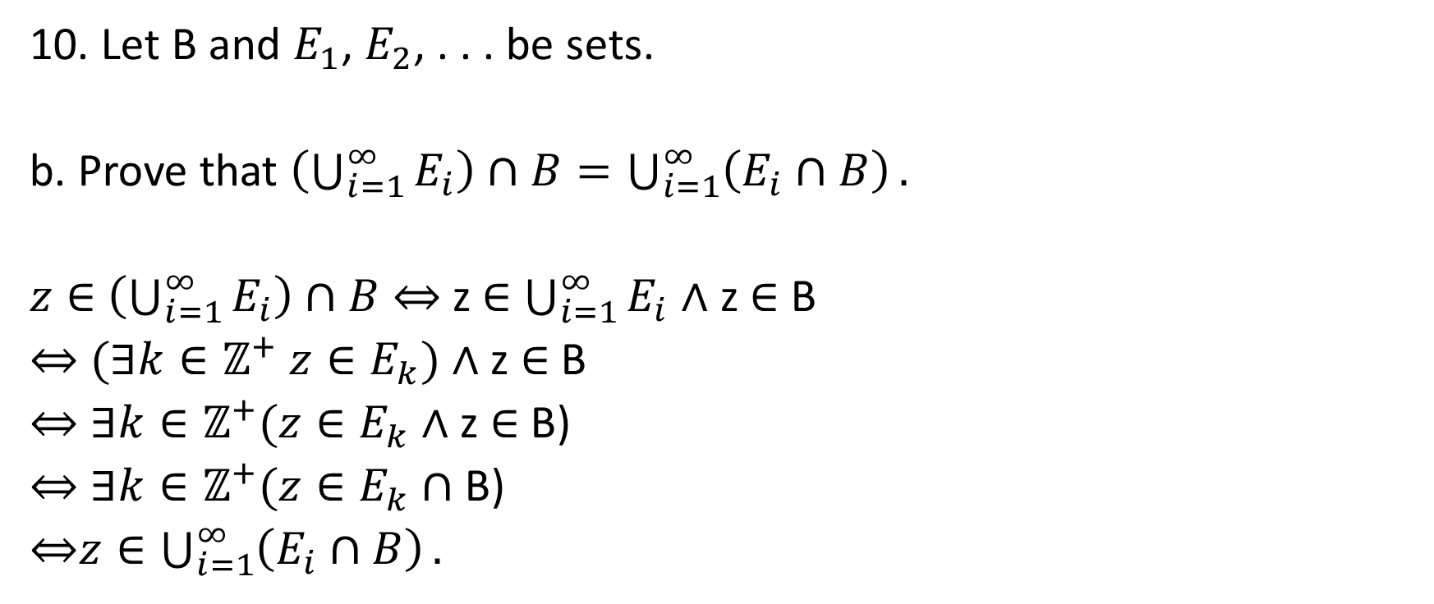
Sheet 3: Question 10
10. Let B and $E_{1}$, $E_{2}$, . . . be sets.
b. Prove that $\left(\bigcup_{i=1}^{∞}{E_{i}}\right)∩B=\bigcup_{i=1}^{∞}{\left(E_{i}∩B\right)}.$
$z∈$ $\left(\bigcup_{i=1}^{∞}{E_{i}}\right)∩B$ ⇔ z ∈ $\bigcup_{i=1}^{∞}{E_{i}}$ ∧ z ∈ B
⇔ $(∃k∈ℤ^{+} z∈E_{k})$∧ z ∈ B
⇔ $∃k∈ℤ^{+}(z∈E_{k}$∧ z ∈ B)
⇔ $∃k∈ℤ^{+}(z∈E_{k}∩$B)
⇔$z∈\bigcup_{i=1}^{∞}{\left(E_{i}∩B\right)}.$

Slide 42
ZFC Set Theory (Non-examinable)
ZF is an abbreviation of Zermelo-Fraenkel.
C is an abbreviation of choice.
Set theory is often thought of the foundation of mathematics because most results in the field can be stated in set notation.
ZFC is the most frequently adopted framework of axioms accepted by mathematicians.
Most of these axioms are widely accepted.

Slide 43
ZFC Set Theory (Non-Examinable)
Extensionality Axiom: Two sets are the same iff they have the same elements.
Empty set Axiom: The empty set exists.
Subset Axiom: A subcollection of a set is a set.
Union Axiom: The union of sets is a set.
Power set Axiom: The power set of a set exists.

Slide 44
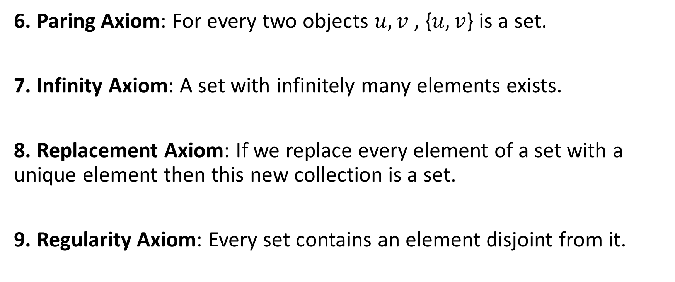
ZFC Set Theory (Non-Examinable)
6. Paring Axiom: For every two objects $u,v$ , {$u,v$} is a set.
7. Infinity Axiom: A set with infinitely many elements exists.
8. Replacement Axiom: If we replace every element of a set with a unique element then this new collection is a set.
9. Regularity Axiom: Every set contains an element disjoint from it.

Slide 45
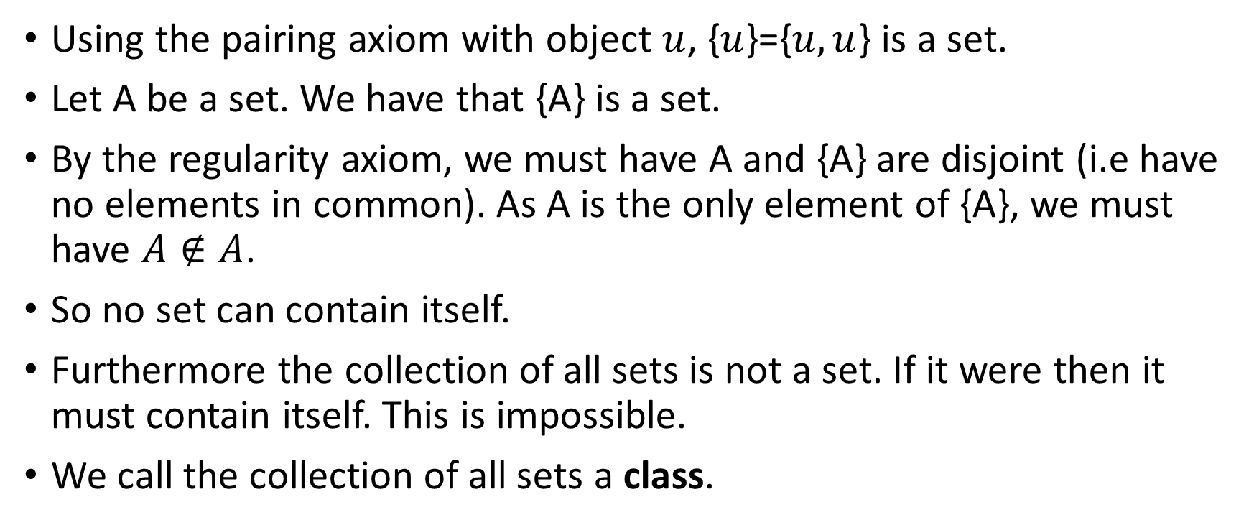
ZFC Set Theory (Non-Examinable)
Using the pairing axiom with object $u$, {$u$}={$u,u$} is a set.
Let A be a set. We have that {A} is a set.
By the regularity axiom, we must have A and {A} are disjoint (i.e have no elements in common). As A is the only element of {A}, we must have $A∉A$.
So no set can contain itself.
Furthermore the collection of all sets is not a set. If it were then it must contain itself. This is impossible.
We call the collection of all sets a class.

Slide 46
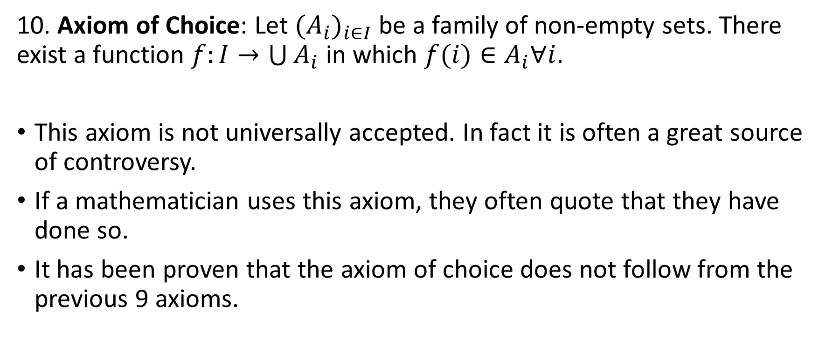
ZFC Set Theory (Non-Examinable)
10. Axiom of Choice: Let ${(A_{i})}_{i∈I}$ be a family of non-empty sets. There exist a function $f:I→\bigcup{A_{i}}$ in which $f(i)∈A_{i}∀i$.
This axiom is not universally accepted. In fact it is often a great source of controversy.
If a mathematician uses this axiom, they often quote that they have done so.
It has been proven that the axiom of choice does not follow from the previous 9 axioms.

Slide 47
ZFC Set Theory (Non-Examinable)
The Axiom of choice has many equivalent forms. Arguably the most notorious of which is Zorn’s Lemma.
Zorn states that any non-empty partial ordered set with the property that every total suborder is bounded above has a maximal element.
Zorn is deduced from the Axiom of Choice using transinfinite induction.
Notable results deduced from Zorn include that every vector space has a basis or that every bounded linear functional on a vector subspace can be extended to the entire space (Hahn-Banach).

Slide 48
New problems (Participation)
For all sets A, B,C, and D, show that if A ∩ C = ∅ then (A × B) ∩ (C × D) = ∅.

Slide 49
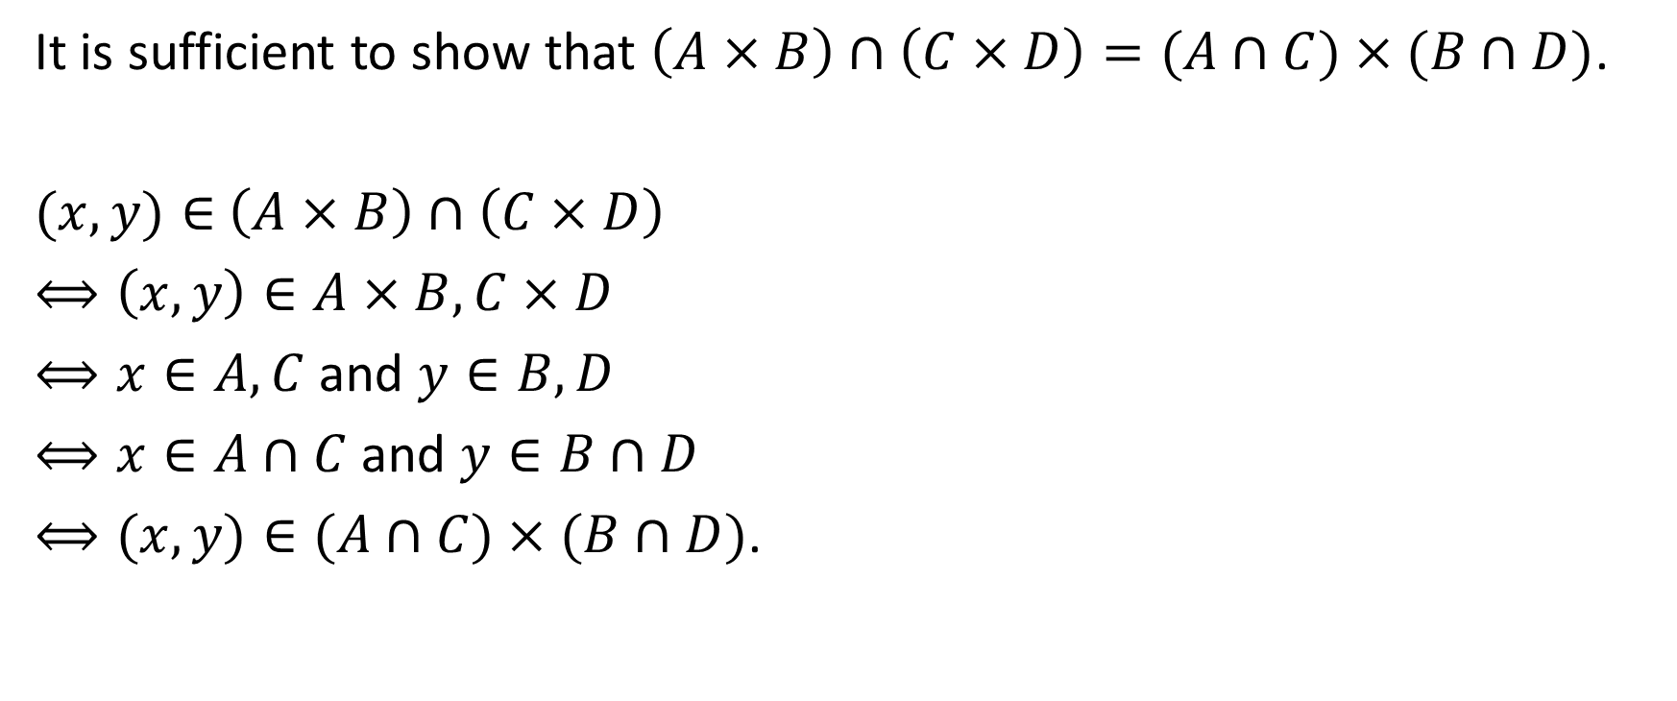
New problem
It is sufficient to show that $\left(A×B\right)∩\left(C×D\right)=(A∩C)×(B∩D)$.
$(x,y)∈$ $\left(A×B\right)∩\left(C×D\right)$
$⟺\left(x,y\right)∈A×B,C×D$
$⟺x∈A,C$ and $y∈B,D$
$⟺x∈A∩C$ and $y∈B∩D$
$⟺(x,y)∈(A∩C)×(B∩D)$.

Slide 50

New problem
Given sets $A$ and $B$, we define their symmetric difference to be
$AΔB≔\left(A\backslash B\right)∪\left(B\backslash A\right).$

Slide 51

New problem
Show that $\left(AΔB\right)ΔC=AΔ(BΔC)$.

Slide 52
Questions

